Slide 1
Shakespeare Text Generation using VAE + Transformer
Deep Learning Course Project

Slide 2
Team
01
Ahmed Saad
02
Marwan Megahed
03
Aml Ashraf
04
Raghad Hany

Slide 3
Background: Using deep learning to create human-like text.
Why It Matters: Powers chatbots, creative writing, and content tools.
Real-World Examples: ChatGPT, auto-completion, AI assistants.
Introduction

Slide 4
Project Goal
Objective: Generate original text in Shakespeare's poetic style.
Core Idea: Combine a VAE (for structured latent space) with a Transformer Decoder (for powerful text generation).
Dataset: Shakespeare's complete works (plays & sonnets).

Slide 5
Dataset & Preprocessing
Source: Shakespeare text dataset.
Cleaning Steps:
Converted to lowercase.
Removed speaker names and special characters.
Added start_token and end_token for sequence control.
Vectorization: Used Keras TextVectorization to convert words to integer sequences (Vocabulary: 20K tokens).

Slide 6
Model Architecture (VAE + Transformer)
BiLSTM network compresses input text into a latent distribution (mean & variance).
A compressed, continuous representation of style and meaning. Allows for interpolation.
Initialized with GloVe (100D) for better word representation.
Our Hybrid Approach
Encoder (VAE)
Latent Space
Decoder (Transformer)
Uses masked self-attention blocks to generate text word-by-word, conditioned on the latent vector.
Embeddings

Slide 7
Training Pipeline
1. Data Processing
2. Model Architecture
3. Training Strategy
4. Key Techniques
5. Generation Process
Raw Text → Numerical Sequences
Clean & lowercase text
Add start/end tokens
Map words to IDs (20K vocabulary)
VAE + Transformer Hybrid:
Encoder: Text → Latent distribution (mean + variance)
Sampling: Reparameterization trick
Decoder: Latent vector → Generated text (Transformer blocks)
Two-Part Loss Function:
Total Loss = Reconstruction Loss + β × KL Loss
Reconstruction: Match original text (cross-entropy)
KL Loss: Regularize latent space
β-annealing: Gradually increase KL weight
Word Dropout: Force diversity (30% rate)
Cosine LR Decay: Smooth convergence
Teacher Forcing: Use previous predictions as input
Autoregressive Decoding:
Encode prompt → Latent vector
Start with token
Repeat: Predict next word → Append → Continue
Stop at token or max length

Slide 8
Complete
6. Quality Control
Results & Generated Text
Temperature Scaling:
Low (0.2): Coherent but repetitive
Medium (0.7): Balanced (our choice)
High (1.5): Creative but less coherent
+ Top-P Sampling: Filter unlikely words
Sample Output (Shakespeare-style):
"the king hath sent his grace to thee and thou art dead a noble mind is here o'erthrown..."
Observations:
Coherence: Text maintains grammatical structure and thematic consistency.
Diversity: Model generates varied sentences, not just repetitions.
Style: Successfully captures archaic vocabulary and poetic rhythm.

Slide 9
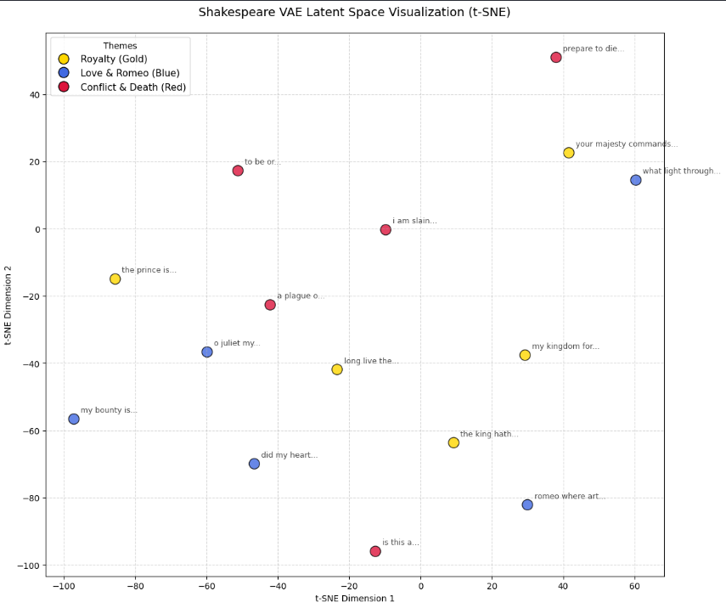
Latent Space Exploration
Interpolation: Smoothly morphs between two prompts (e.g., "the king hath sent" → "romeo where art thou").
Visualization (t-SNE): Shows the model clusters similar themes (love, royalty, conflict) in different regions of the latent space.
Controlled Generation: By navigating the latent space, we can control the style and content of the output.

Slide 10
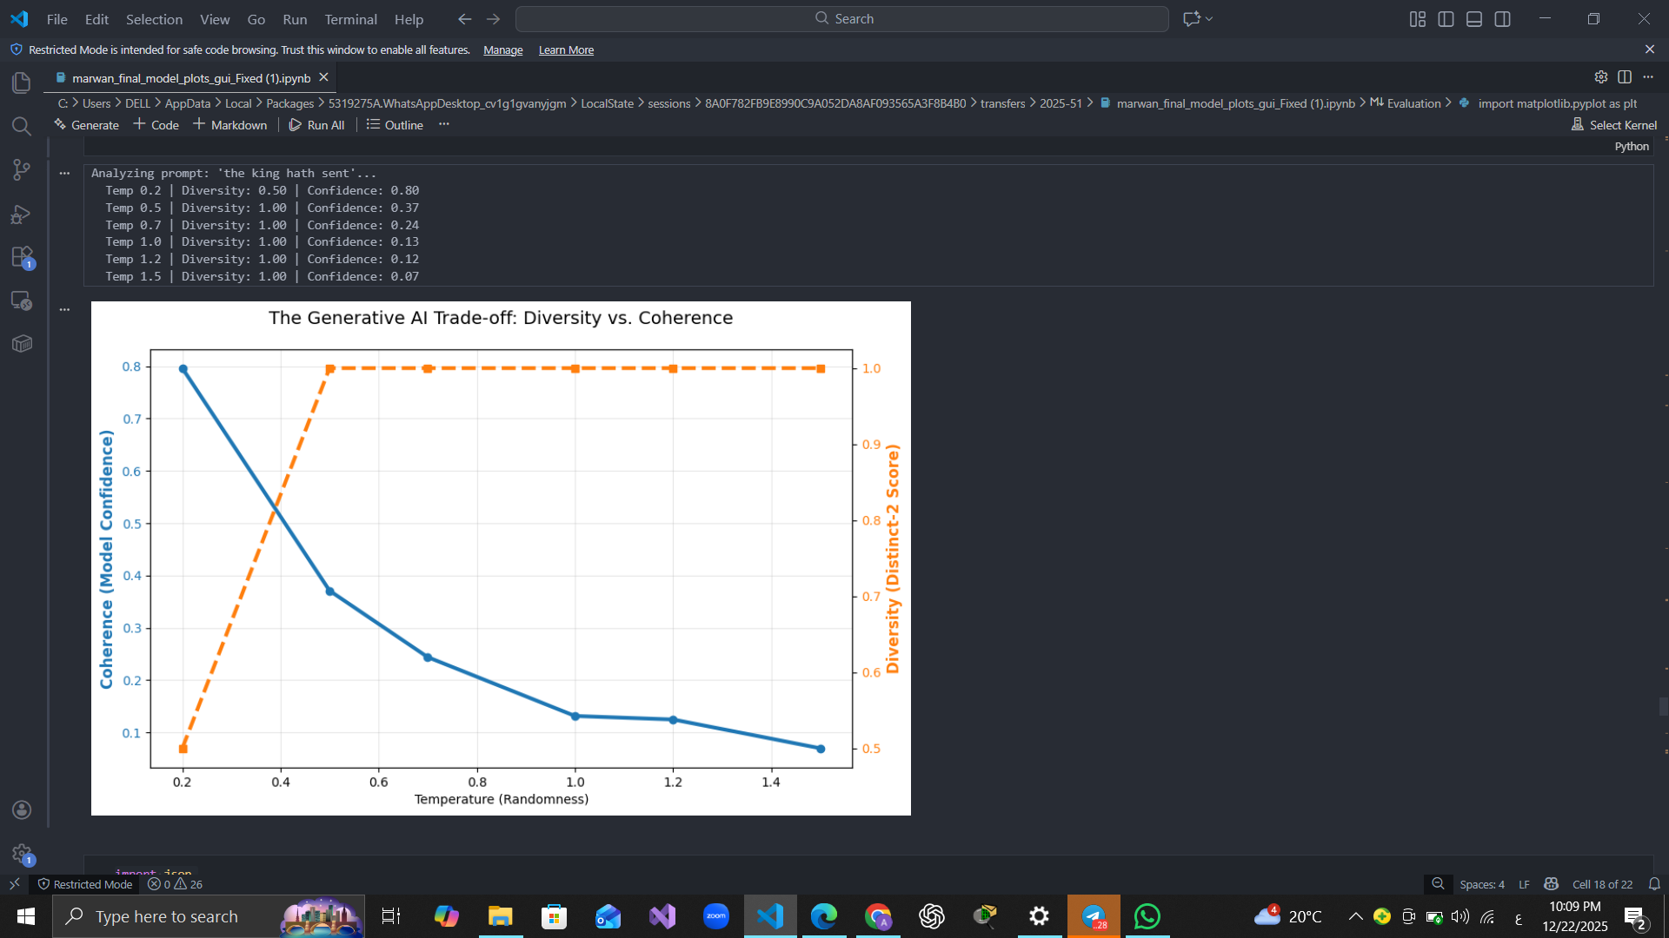
The Coherence-Diversity Trade-off
Finding: The Temperature parameter controls a key trade-off:
Low Temp (e.g., 0.2): High coherence, but repetitive and safe.
High Temp (e.g., 1.5): High diversity and creativity, but lower coherence.
Our Choice: Used a balanced temperature (~0.7) with Top-P (Nucleus) Sampling for the best mix.

Slide 11
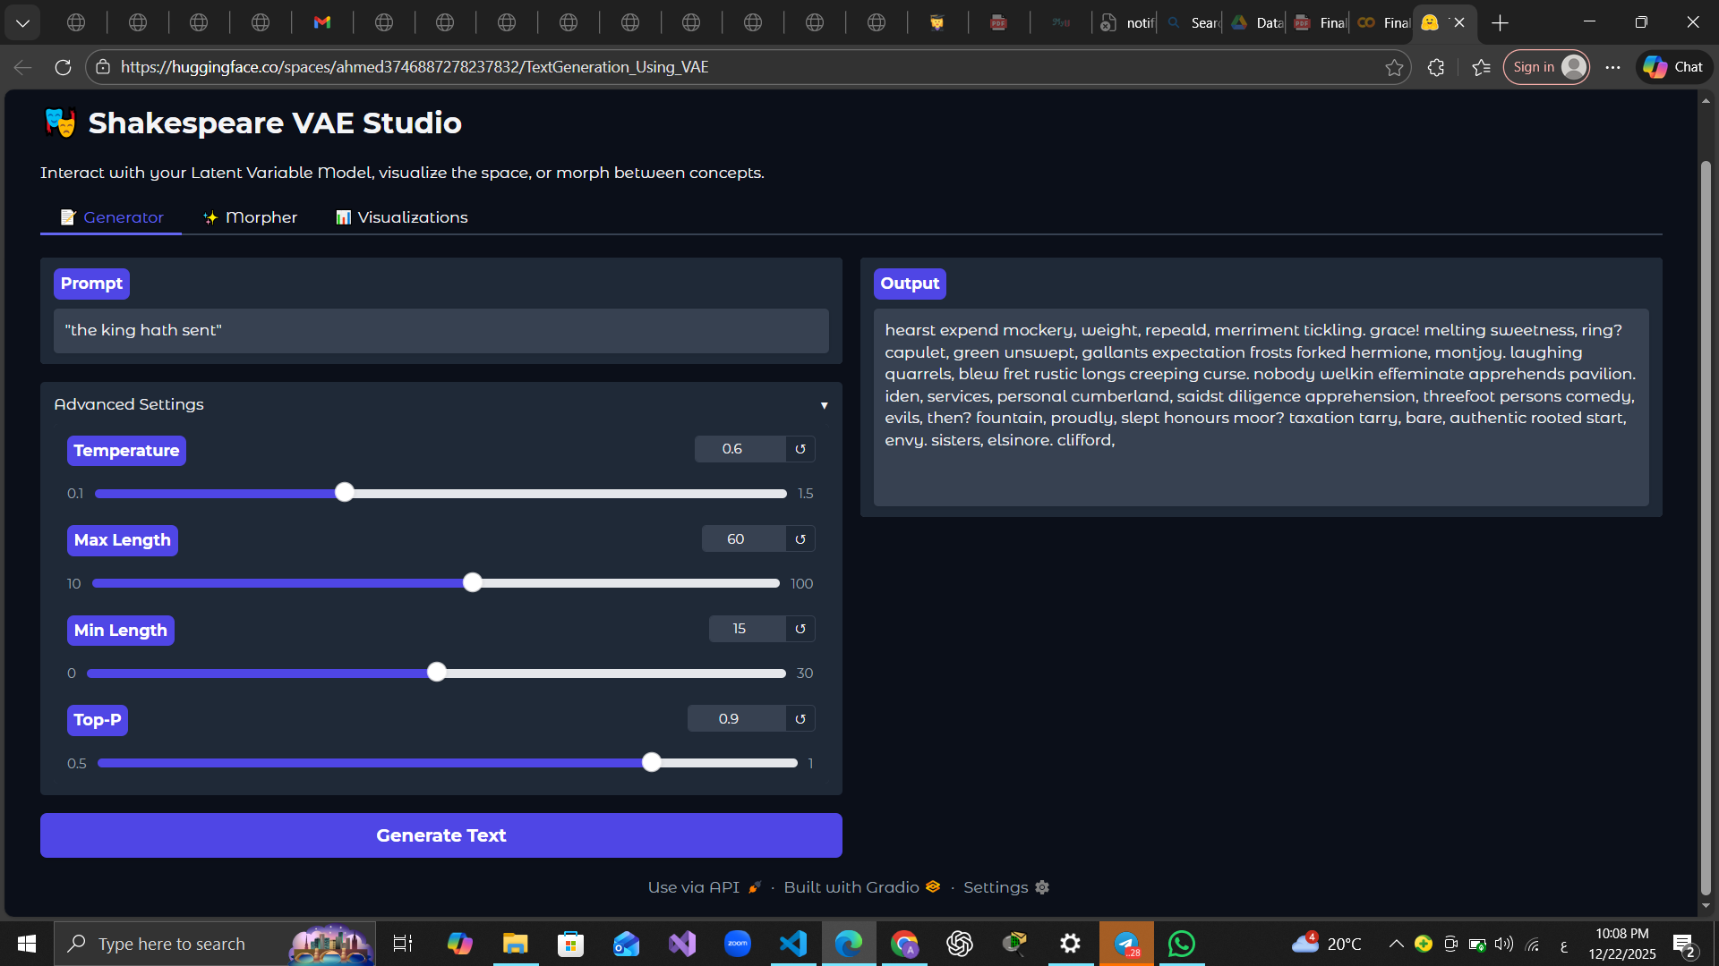
Interactive Demo (Gradio)
We built a web interface to interact with our model:
Feature 1: Text Generator – Input a prompt, get a Shakespearean continuation.
Feature 2: Sentence Morpher – Visually interpolate between two ideas in the latent space.
Live Demo: Users can experiment with temperature and length settings.

Slide 12
Summary: Successfully built a hybrid model that generates coherent, Shakespeare-style text.
VAE + Transformer Synergy: VAE provides a structured, interpolatable latent space; the Transformer enables high-quality sequence generation. The combination is powerful for controlled creativity.
Future Work:
Scale up model size and dataset.
Incorporate more control (e.g., control emotion, rhyme scheme).
Extend to a full encoder-decoder Transformer for more complex tasks.
Conclusion & Learnings

Slide 13
Links
DataSet
https://www.kaggle.com/datasets/kingburrito666/shakespeare-plays
GUI
https://huggingface.co/spaces/ahmed3746887278237832/TextGeneration_Using_VAE

Slide 14
Thank you!

